Slide 1
Chapter-Five Perception and Individual Decision Making
Md. Mostakin Arafat Riaz
Lecturer
Department of Business Administration
Sonargaon University

Slide 2
Perception
Perception is a process by which we organize and interpret sensory impressions to give meaning to our environment. What we perceive can be substantially different from objective reality.
For example, all employees in a firm may view it as a great place to work – favorable working conditions, interesting job assignments, good pay, excellent benefits, understanding and responsible management – but, as most of us know, it’s very unusual to find universal agreement across people.
Perception is important in organizational behavior because people’s behavior is based on their perception of what reality is, not on reality itself.

Slide 3
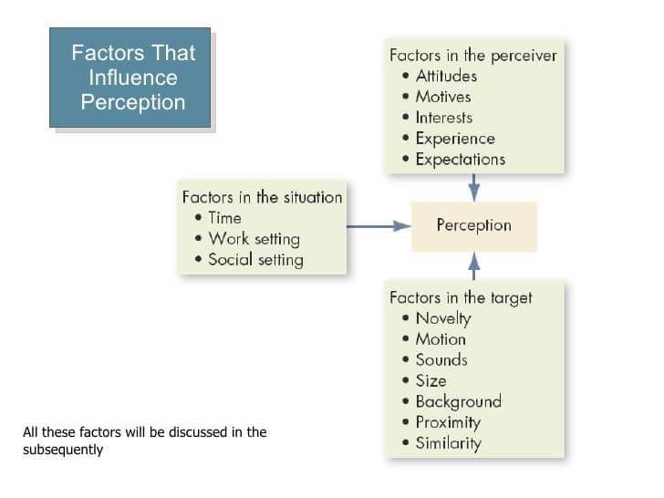
Factors That Influence Perception
Many factors shape and sometimes distort perception. These factors can reside in the perceiver, the object or target being perceived, or the situation in which the perception is made.

Slide 4
Factors That Influence Perception
Factors in the Perceiver: The factors in the perceiver that affect perception are:
Attitudes- Attitudes have a powerful influence on what we pay attention to, what we remember, and how we interpret information. Different attitudes lead to different interpretations.
Motives- Motives stimulate individuals. It is unsatisfied need. They exert strong influence on perception. For example; hungry people tend to see images of food.
Emotions- An individual’s emotional state strongly influences perception. Anger and frustration distort perception.

Slide 5
Factors That Influence Perception
Interests- Individual interests differ considerably. Interest influences the focus of attention. Differences in individual interests result in differing perceptions.
Experiences- Past experiences affect the focus of attention. Individuals tend to perceive those objects or events to which they can relate to.
Expectations- People see what they expect to see.

Slide 6
Factors That Influence Perception
Factors in the Target: The factors in the target that affect perception are:
Novelty- Novelty targets are more likely to be noticed than the targets observed in the past.
Motion, sound, size- They shape the way we see the target. Loud people are more likely to be noticed.
Background- A target is not looked at in isolation. The relationship of target to its background influences perception.
Proximity- Objects that are close to each other tend to be perceived together.
Similarity- Similar things need to be grouped together. For example; black people are perceived as alike even in unrelated characteristics.

Slide 7
Factors That Influence Perception
Factors in the Situation: The factors in the situation that affect perception are:
Time- The time at which an object or event is seen affects perception. For example; a daily report arriving after two days may be ignored by the perceiver.
Work setting- The changing context of the work setting influences perception. For example; stressful work situations distort perception.
Social setting- The changing social setting influences perception. For example; a male student wearing earrings may not be noticed in a disco but highly noticeable in the classroom.

Slide 8
Common Shortcuts in Judging Others
Shortcuts for judging others often allow us to make accurate perception rapidly and provide valid data for making predictions. However, they can and do sometimes result in significant distortions. These are –
Selective Perception
Halo and Horns Effects
Contrast Effects
Stereotyping

Slide 9
Common Shortcuts in Judging Others
Selective Perception: It is impossible for us to assimilate everything we see; we can take in only certain stimuli. Because we can not observe everything going on around us, we use selective perception. But we don’t choose randomly. We make selections based on our perceptions. Selective perception is the tendency to choose to interpret what one sees based on one’s interest, background, experience and attitudes. Seeing what we want to see, we sometimes draw unwarranted conclusions from an ambiguous situation.

Slide 10
Common Shortcuts in Judging Others
Halo and Horns Effects: Halo effect is the tendency to draw a positive general impression about an individual based on a single characteristic. Such as intelligence, sociability, or appearance. Horns effect is the tendency to draw a negative general impression about an individual based on a single characteristic. These effects are easy to demonstrate.

Slide 11
Common Shortcuts in Judging Others
Contrast Effect: Contrast effect is the evaluation of a person’s characteristics that is affected by comparisons with other people recently encounter who rank higher or lower on the same characteristics. We don’t evaluate a person in isolation. Our reaction is influenced by other people we have recently encountered. For example, research on 22 teams in a Chinese hospitality organization that was undergoing radical organizational change and new leader appointments suggests that transformational leadership is more effective in improving support for the changes among followers when the former leader was not transformational.

Slide 12
Common Shortcuts in Judging Others
Stereotyping: Stereotyping means judging based on one’s perception of the group to which that person belongs. We deal with our complex world’s unmanageable number of stimuli by using stereotypes or shortcuts called heuristics to make decision quickly.

Slide 13
Decision
Decision is a choice among two or more alternatives.
Managers at all levels and in all areas of organization make decisions. That is they make choices.
For instance, top-level managers make decisions about their organization’s goals, where to locate manufacturing facilities, or what new markets to move into.
Middle-lower level managers make decisions about production schedules, product quality problem, pay raises, and employee discipline.
Our focus on this chapter is on how managers make decisions.

Slide 14
Decision-Making Conditions
When making decisions, managers may face three different conditions. These are-
Certainty
Risk
Uncertainty
Decision-Making Under Certainty: The ideal situation for making decision is one of certainty, a situation where a manager can make accurate decisions because the outcomes of every alternative is known. For example, entrepreneurs and business managers in Sweden can be certain they will receive prompt payment for goods and services when they decide to allow customers to make purchases through financial service apps.

Slide 15
Decision-Making Conditions
Decision-Making Under Risk: A far more common situation is one of risk, conditions in which the decision maker is able to estimate the likelihood of certain outcomes. Under risk managers have historical data from past personal experiences or secondary information that lets them assign probabilities to different alternatives.
Decision-Making Under Uncertainty: Uncertainty is a situation in which a decision maker has neither certainty nor reasonable probability estimates available. Under these conditions, the choice of alternatives is influenced by the limited amount of available information and by the psychological orientation of the decision maker.

Slide 16
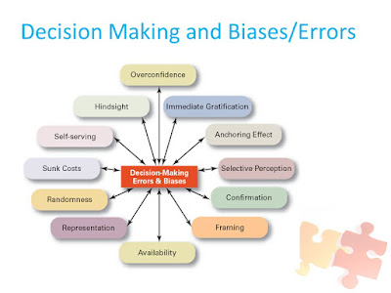
Decision-Making Biases and Errors
When managers make decisions, they may use the “rules of thumb”, or heuristics, to simplify their decision making. Rules of thumb can be useful because they help make sense of complex, uncertain, and ambiguous information. Even though managers may use rules of thumb, that doesn’t mean those rules are reliable.

Slide 17
Decision-Making Biases and Errors
Overconfidence Bias: When decision makers tend to think they know more than they do or hold unrealistically positive views of themselves and their performance, they are exhibiting the overconfidence bias.
Immediate Gratification Bias: The immediate gratification bias describes decision makers who tend to want immediate rewards and to avoid immediate costs. For these individuals decision choices that provide quick payoffs are more appealing than those with payoffs in the future.
Anchoring Effect: The anchoring effect describes how decision makers fixate on initial information as a starting point and then, once set, fail to adequately adjust for subsequent information. First impressions, ideas, prices, and estimates carry unwarranted weight relative to information received later.

Slide 18
Decision-Making Biases and Errors
Selective Perception Bias: When decision makers selectively organize and interpret events based on their biased perceptions, they are using the selective perception bias. This influences the information they pay attention to, the problems they identify, and the alternatives they develop.
Confirmation Bias: Decision makers who seek out information that reaffirms their past choices and discounts information that contradicts past judgements exhibit the confirmation bias.
Framing Bias: The framing bias occurs when decision makers select and highlight certain aspects of a situation while excluding others. By drawing attention to specific aspects of a situation while excluding others. By drawing attention to specific aspects of a situation and highlighting them.

Slide 19
Decision-Making Biases and Errors
Availability Bias: The availability bias happens when decision makers tend to remember events that most recent and vivid in their memory. It distorts their ability to recall events in an objective manner and results in distorted judgements and probability estimates.
Representation Bias: When decision makers assess the likelihood of an events based on how closely it resembles other events or sets of events, that’s the representation bias. Managers exhibiting this bias draw analogies and see identical situations where they don’t exist.
Randomness Bias: The randomness bias describes the actions of decision makers who try to create meaning out random events. They do this because most decision makers have difficulty dealing with chance even though random events happen to everyone, and there is nothing that can be done to predict them.

Slide 20
Decision-Making Biases and Errors
Sunk Costs Error: The sunk cost error occurs when decision makers forget that current choices can’t correct the past. They incorrectly fixate on past expenditures of time, money, or effort in assessing choices rather than on future consequences. Instead of ignoring sunk costs, they can’t forget them.
Self-serving Bias: Decision makers who are quick to take credit for their successes and to blame failure on outside factors are exhibiting the self-serving bias.
Hindsight Bias: Finally, the hindsight bias is the tendency for decision makers to falsely believe that they would have accurately predicted the outcome of an event once that outcome is actually known.

Slide 21
END OF CHAPTER
HAVE A GOOD DAY

